Slide 1
Weekly Progress
Week 12 & 13

Slide 2
What do we need to improve from last year’s work ?
Lip synchronisation => Wav2Lip(removing teeth) produces blurry mouth region
Emotion Generation => currently cannot generate emotion well, distorts faces
Head movement / Pose => No head movement at all
Resolution => DeepFaceLab used but it can be used only with the single image whereas Deep-fake requires multiple face images to train the model

Slide 3

PC-AVS (result from last meeting)
Lip synchronisation is pretty good
Head movement seems pretty natural
Face looks a bit different from the original image (the images given in the github for demo was fine but running with our photos seemed a bit different even though preprocessing was done)

Slide 4



Applying median filter to PC-AVS
Offset 8 Offset 14 Offset 20
Applied median filter to solve the area around eyes → did not make much difference, made the lip synchronisation worse

Slide 5


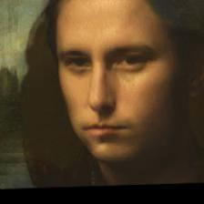
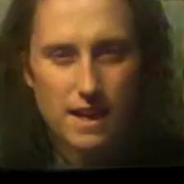

PC-AVS with sad Monalisa image (from last year’s project
Output video
Input pose source
+
Input video
+

Slide 6
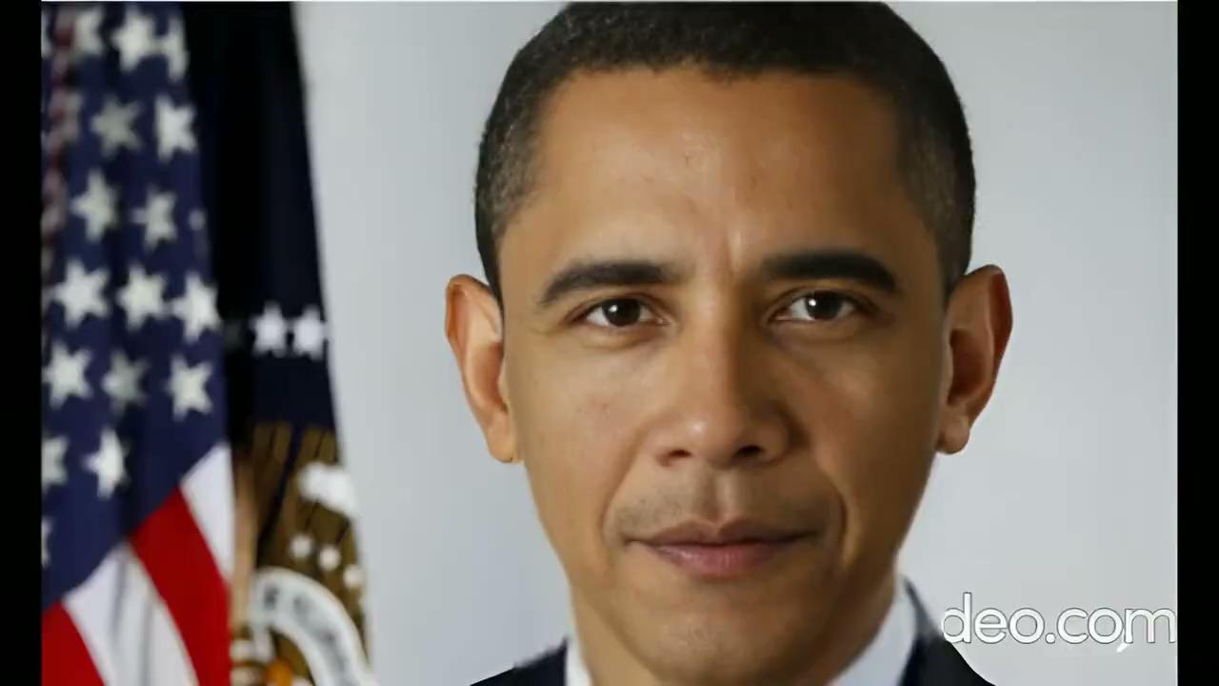
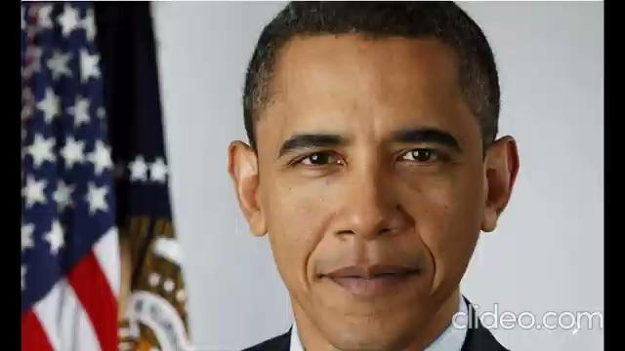
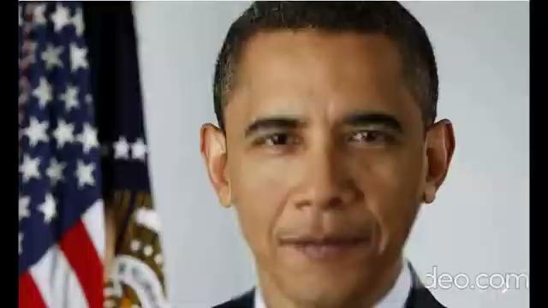
Wav2lip + codeformer
Codeformer
Input source (image → video)
Wav2lip applied
Codeformer applied

Slide 7
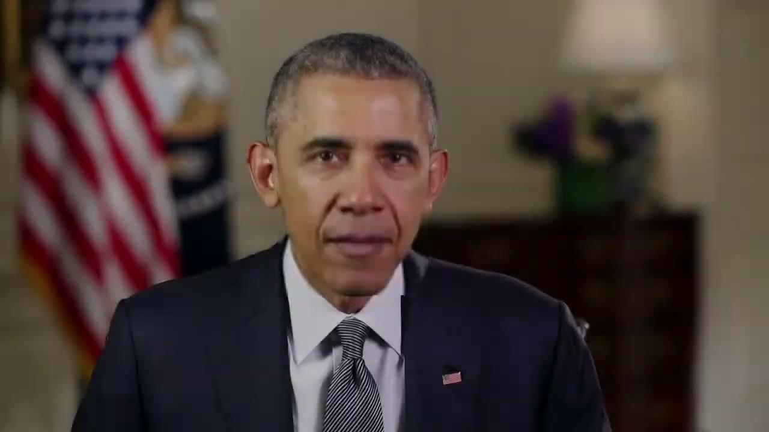

Wav2lip + SPT + CodeFormer (Codebook Lookup Transformer)
Wav2lip + SPT
Codeformer applied

Slide 8
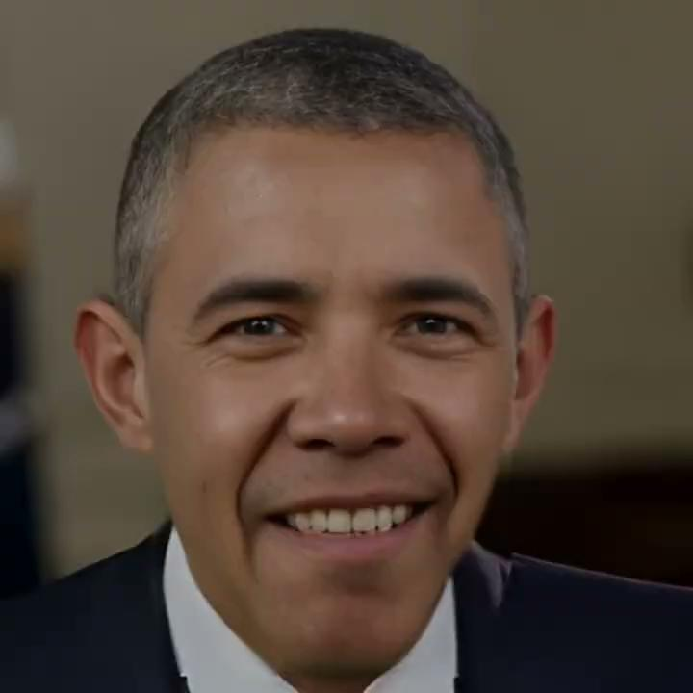

Obama happy + Codeformer
Emotion+ Wav2lip + SPT
Codeformer applied

